Slide 1
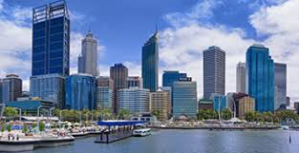
Liveability
What makes a place liveable?

Slide 2
Brainstorm – liveability

Slide 3
What do you think is the most liveable city in the world?

Slide 4
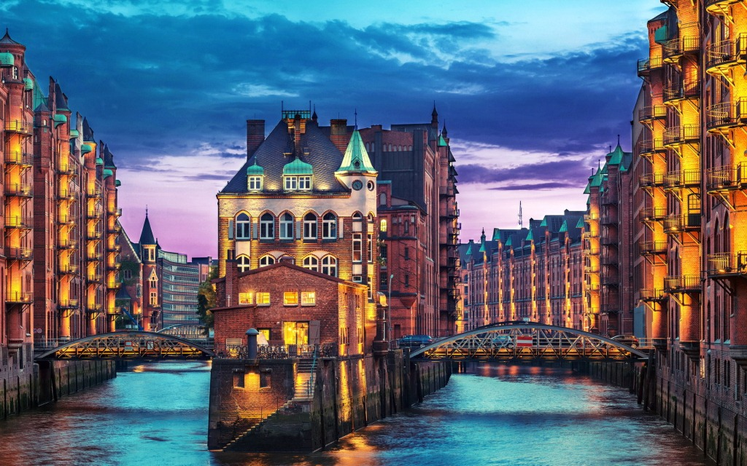
Most Liveable cities 2017
10. Hamburg, Germany

Slide 5
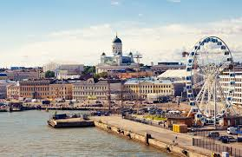
Most Liveable cities 2017
9. Helsinki, Finland

Slide 6
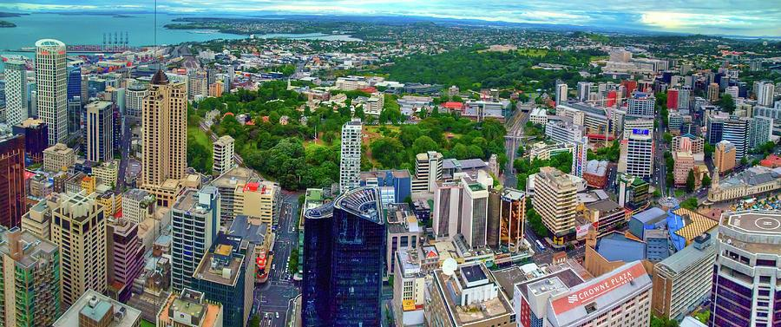
Most liveable cities 2017
8. Auckland, New Zealand

Slide 7
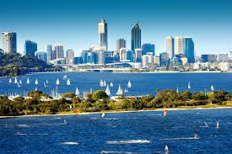
Most Liveable cities 2017
7. Perth, Australia

Slide 8
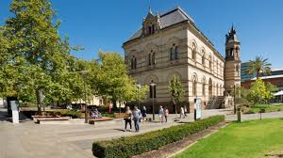
Most Liveable cities 2017
6. Adelaide, Australia

Slide 9
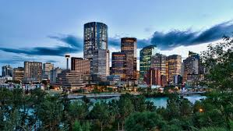
Most Liveable cities 2017
5. Calgary, Canada

Slide 10
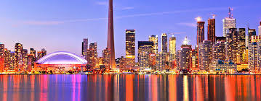
Most Liveable cities 2017
4. Toronto, Canada

Slide 11
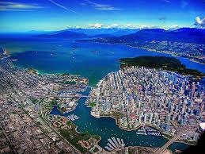
Most Liveable cities 2017
3. Vancouver, Canada

Slide 12
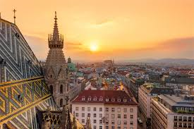
Most Liveable cities 2017
2. Vienna, Austria

Slide 13
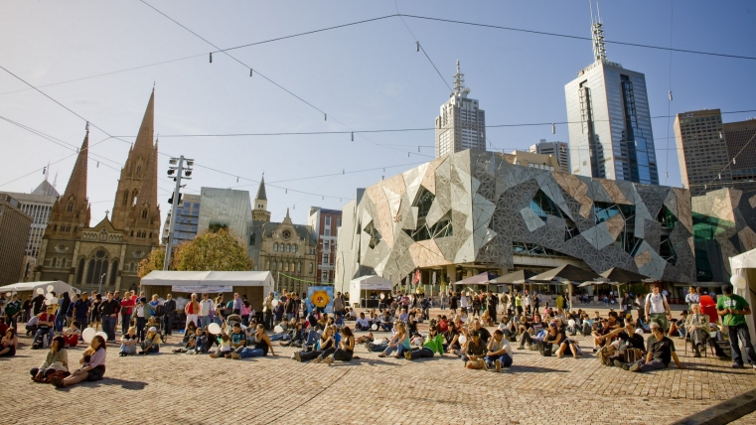
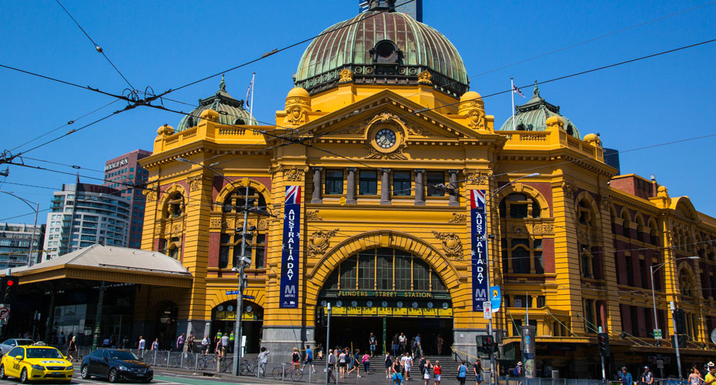
Most Liveable cities 2017
1. Melbourne, Australia

